Slide 1

ESA Sentinel Data
Philippe Bonnet
phbo@itu.dk
Scalable Web Systems

Slide 2
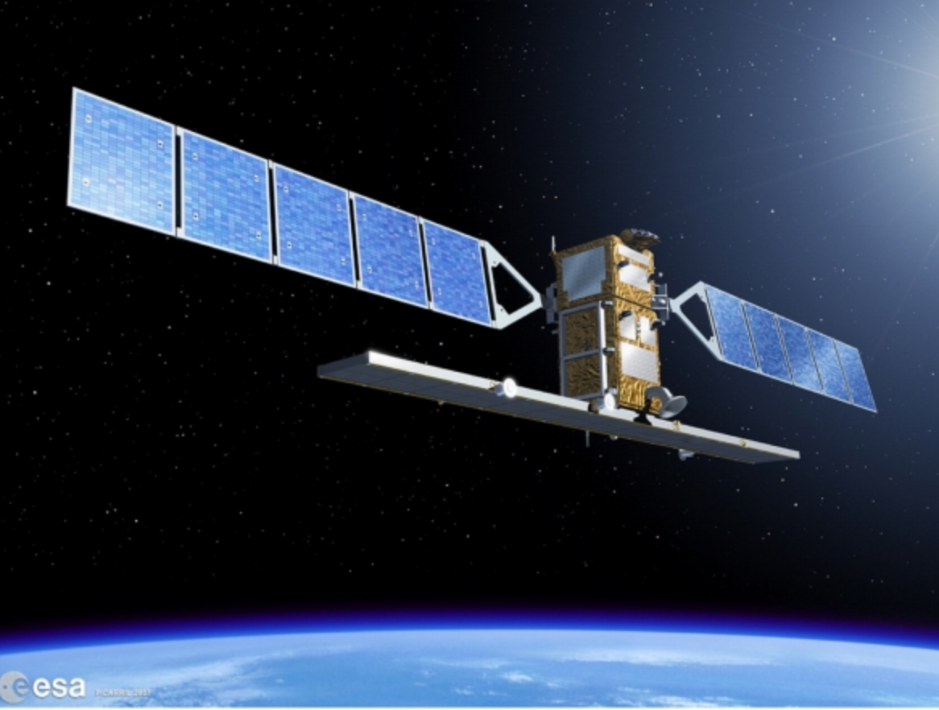

Slide 3
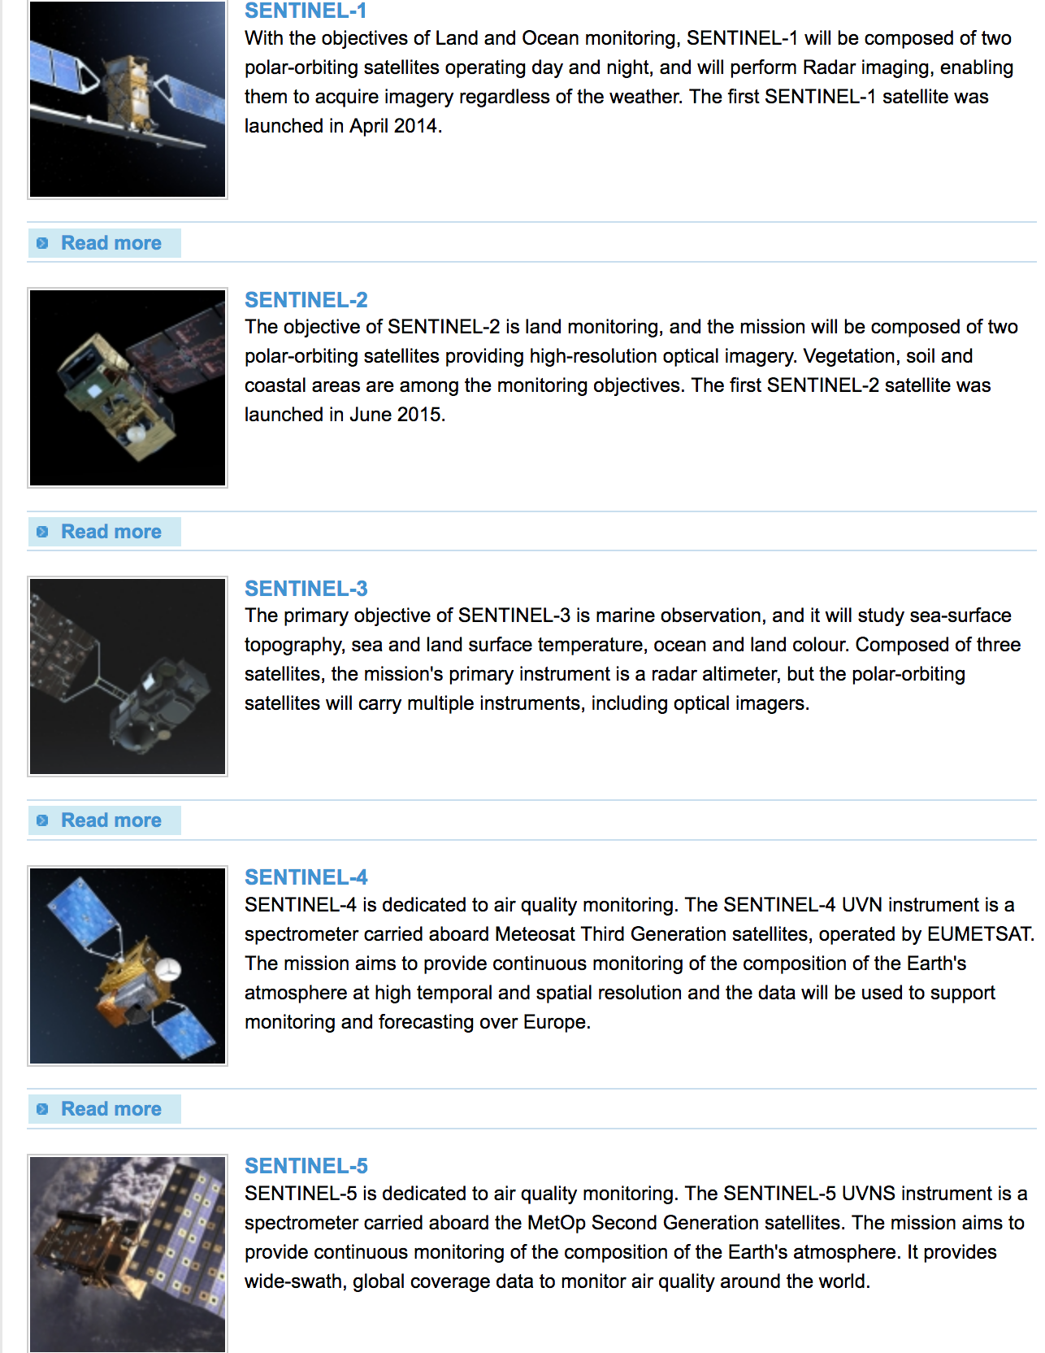

Slide 4
Next Launch
“The challenging task of flying Sentinel-5P throughout its planned seven-year mission starts just 93 minutes after liftoff on 13 October, set for 09:27 GMT (11:27 CEST), on a Rockot from Russia’s Plesetsk Cosmodrome. “

Slide 5
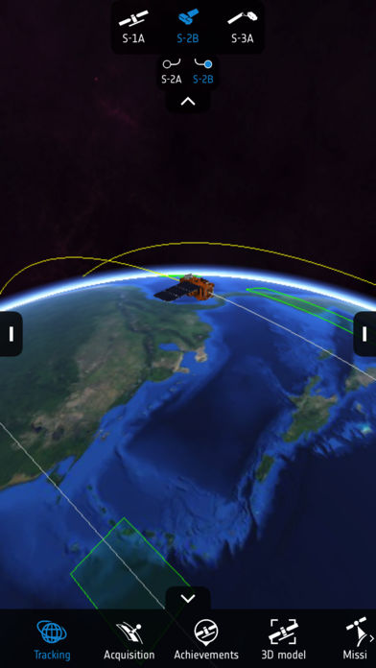
The App

Slide 6
Sentinel Services
Copernicus services will provide essential information for six main domains: ocean, land and atmosphere monitoring, emergency response, security and climate change.
Services relevant to the marine environment include monitoring for marine safety and transport, oil-spill detection, water quality, weather forecasting and the polar environment.
Services relevant to the land environment include monitoring for water management, agriculture and food security, land-use change, forest monitoring, soil quality, urban planning and natural protection services.
Services relevant to the atmospheric include monitoring for air quality and ultraviolet radiation forecasts, greenhouse gases and climate forcing.
Services for emergency management response will help mitigating the effects of natural and manmade disasters such as floods, forest fires and earthquakes and contribute to humanitarian aid exercises.
Services for security will support peace-keeping efforts, maritime surveillance and border control.
Services for monitoring climate change cross-cut all of the above domains.

Slide 7
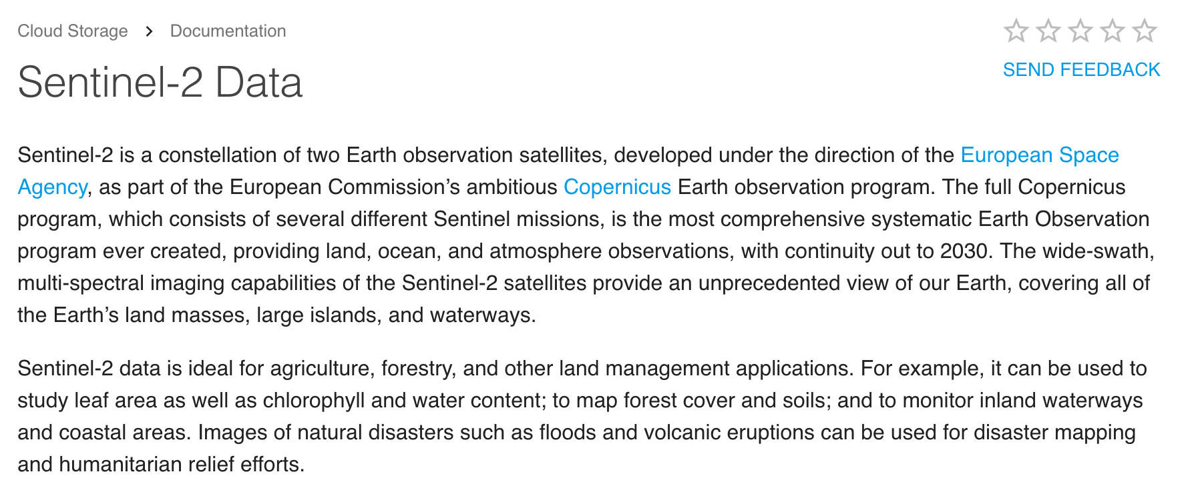
Sentinel data on Google Cloud Platform
https://cloud.google.com/storage/docs/public-datasets/sentinel-2

Slide 8
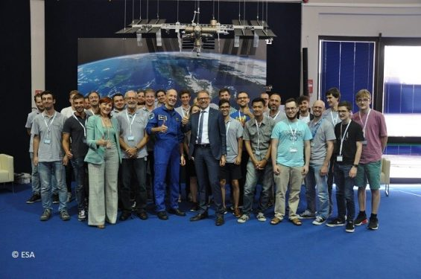
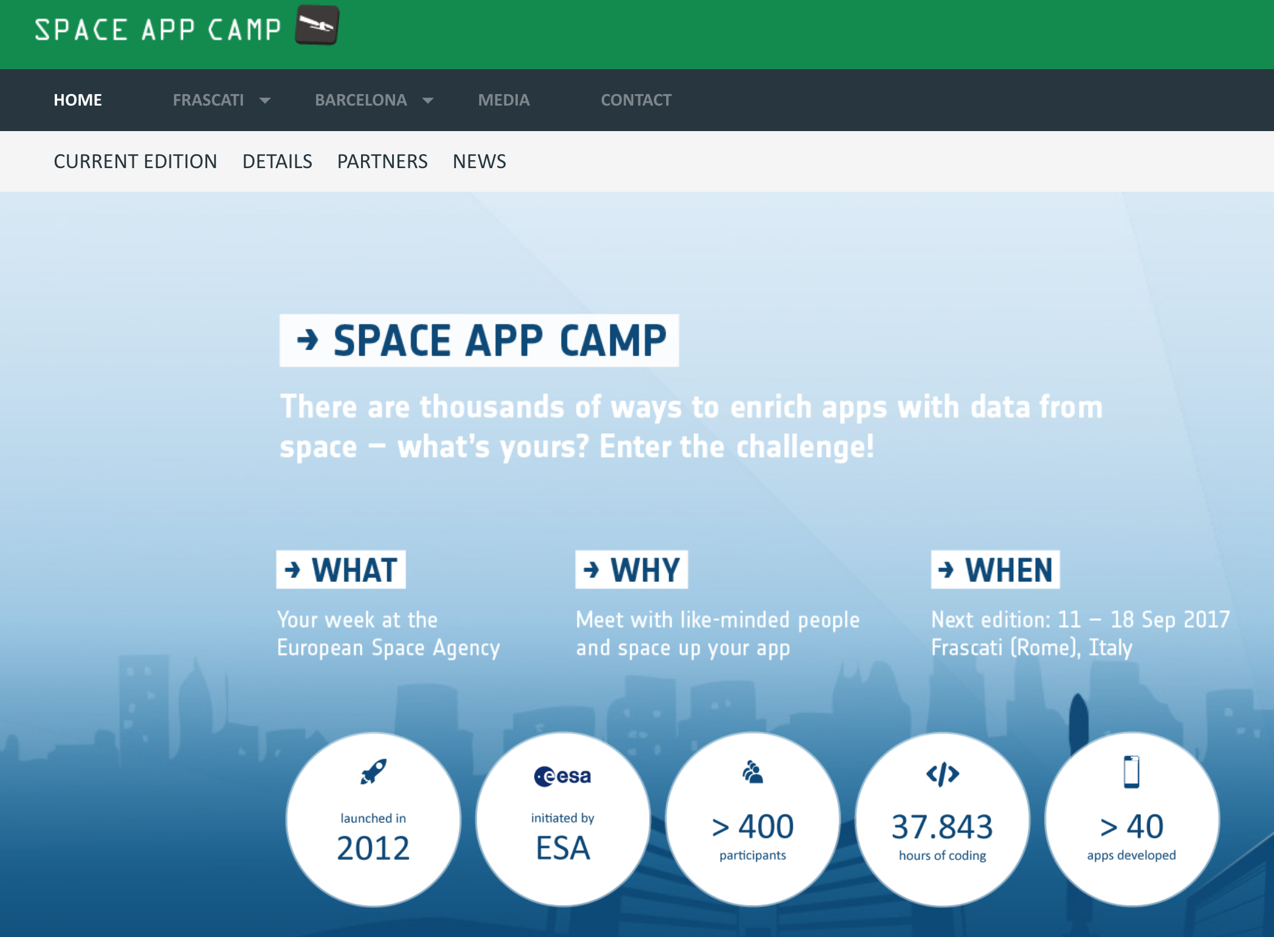
Space App Camp

Slide 9
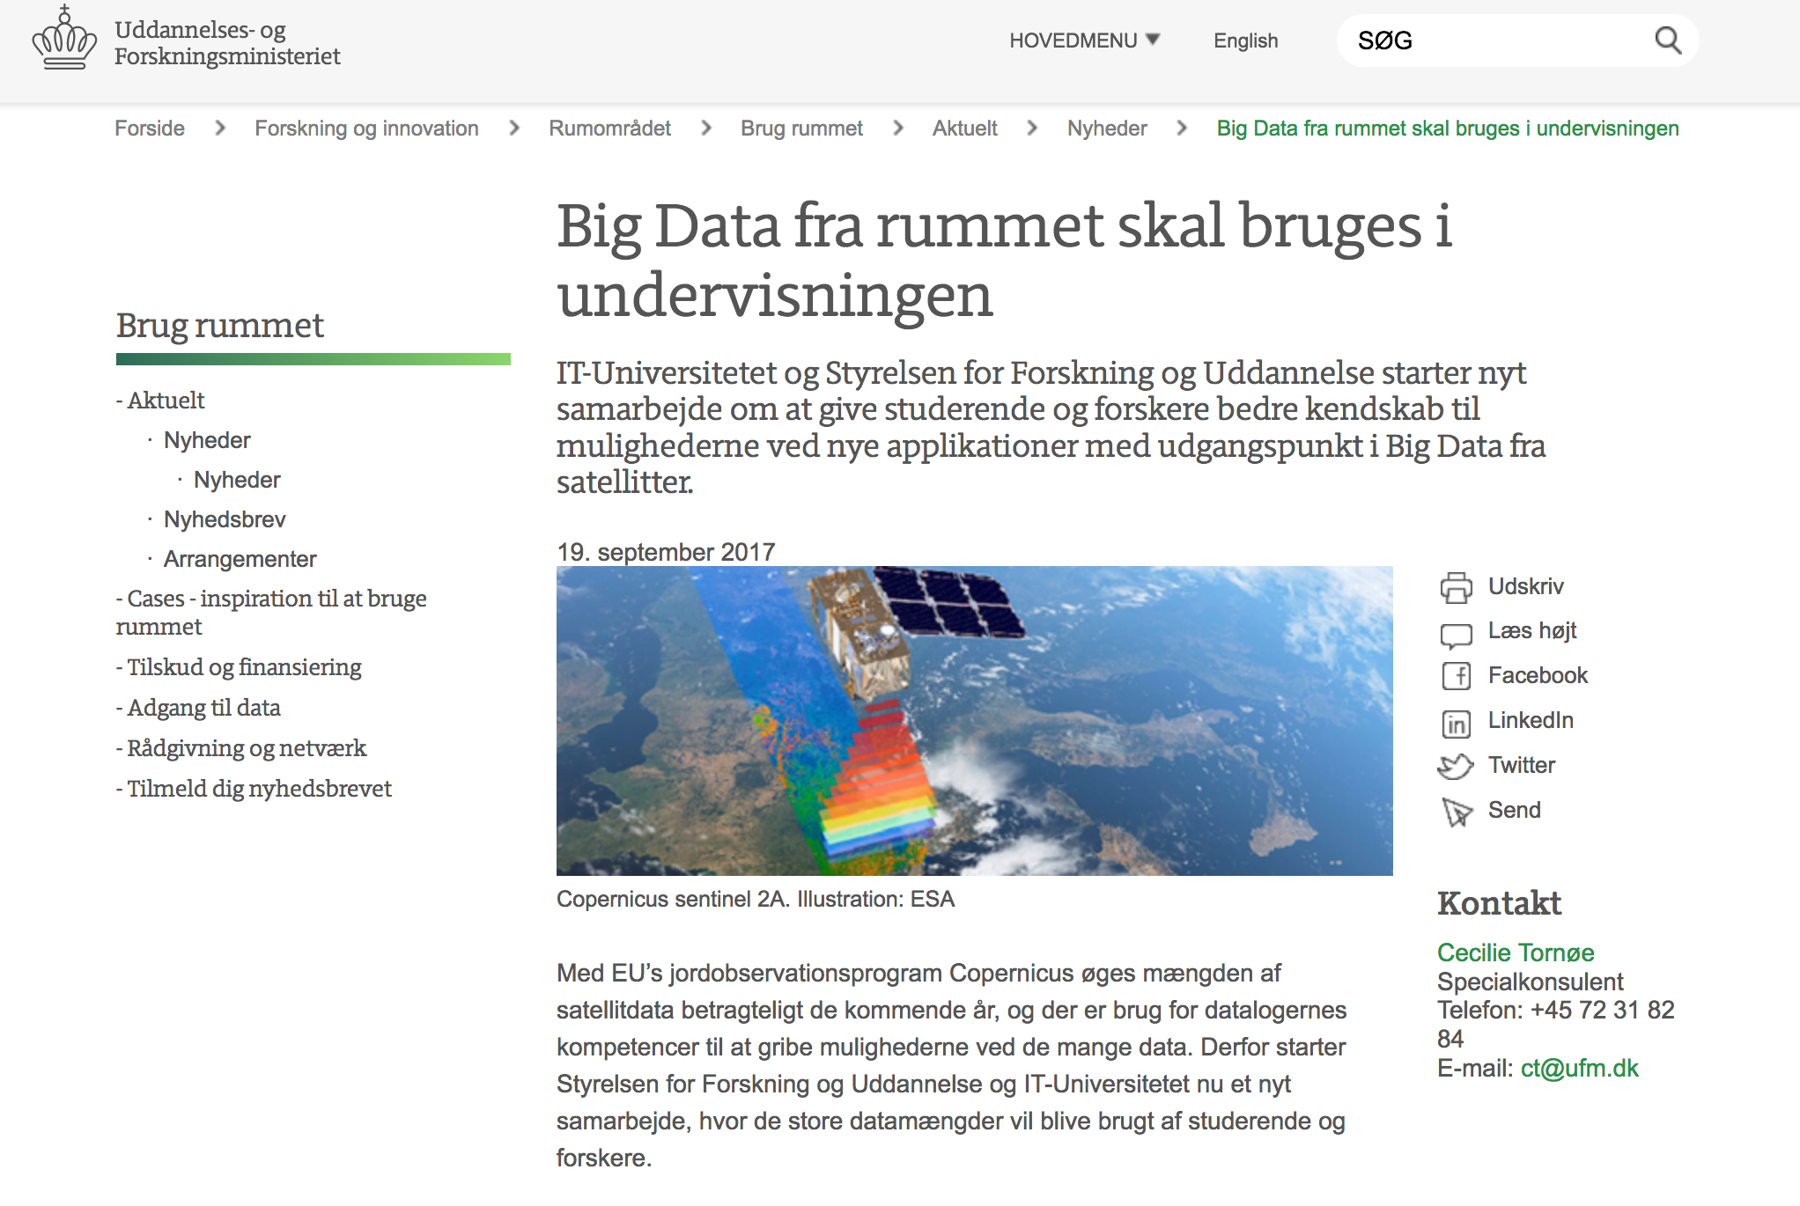
https://ufm.dk/forskning-og-innovation/rumomradet/brug-rummet/

